Slide 1
Searching
Md Mehrab Hossain Opi
CSE 4109: Artificial Intelligence

Slide 2
Artificial Intelligence
What is AI?
The Art of creating machines that perform functions that require intelligence when performed by people.
The ability to think and understand instead of doing things by instinct or automatically.

Slide 3
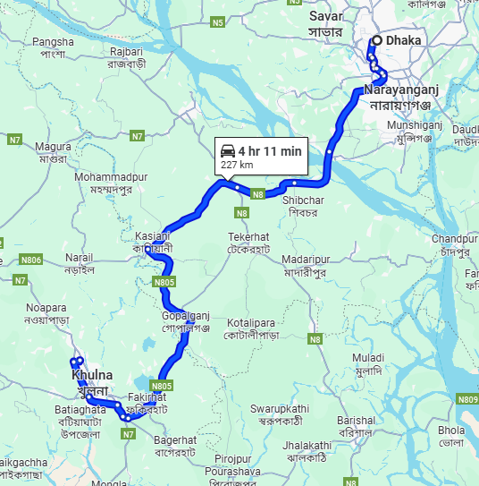
Artificial Intelligence
Do you think this is AI?

Slide 4
Searching in AI
AI is all about searching.
Searching for a solution of a given problem.
Or
Searching for the steps to complete a task.
Search for direction to reach a destination.
Search for an answer when asked in LLM(ChatGPT).
Search for the next step in chess to win the game.

Slide 5
Basic Terminology
Agent
An entity that perceives its environment and acts upon that environment.
A robot?
A car?
A human?
A game character?

Slide 6
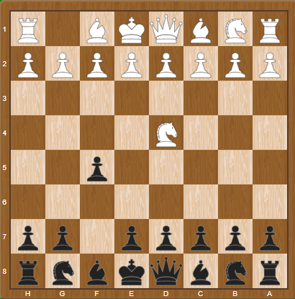
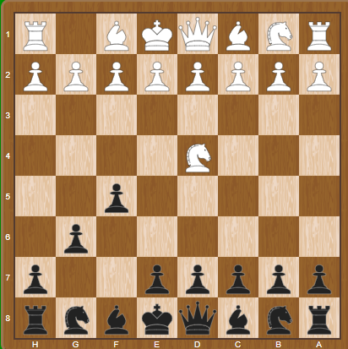
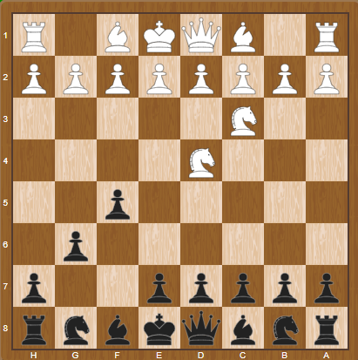
Basic Terminology
State
A state is a specific configuration of the agent and its environment at a given time.

Slide 7
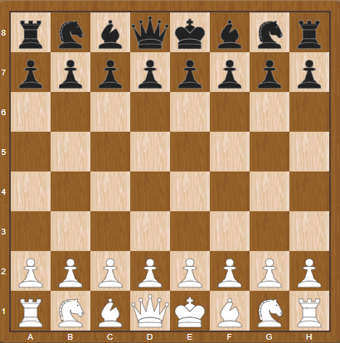
Basic Terminology
Initial State
The state in which the agent begins.

Slide 8
Basic Terminology
Actions
Choices that can be made in a state.
20 possible moves in the first move of a chess game.
ACTIONS(s)
A function that returns the set of actions that can be executed in state s.

Slide 9
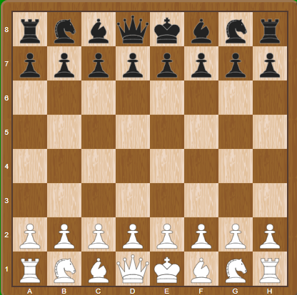
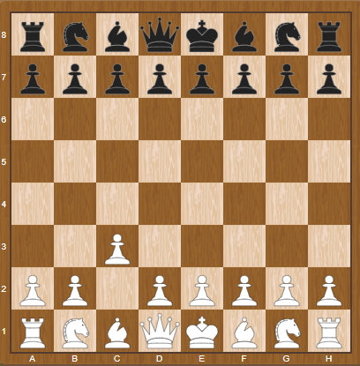
Basic Terminology
Transition Model
A description of what state results from performing any applicable action in any given state.
RESULT(s,a)
A function that returns the state resulting from performing action a in state s.
RESULT( , ‘c2c3’) =

Slide 10
Basic Terminology
State Space
The set of all states reachable from the initial state by any sequence of action.

Slide 11
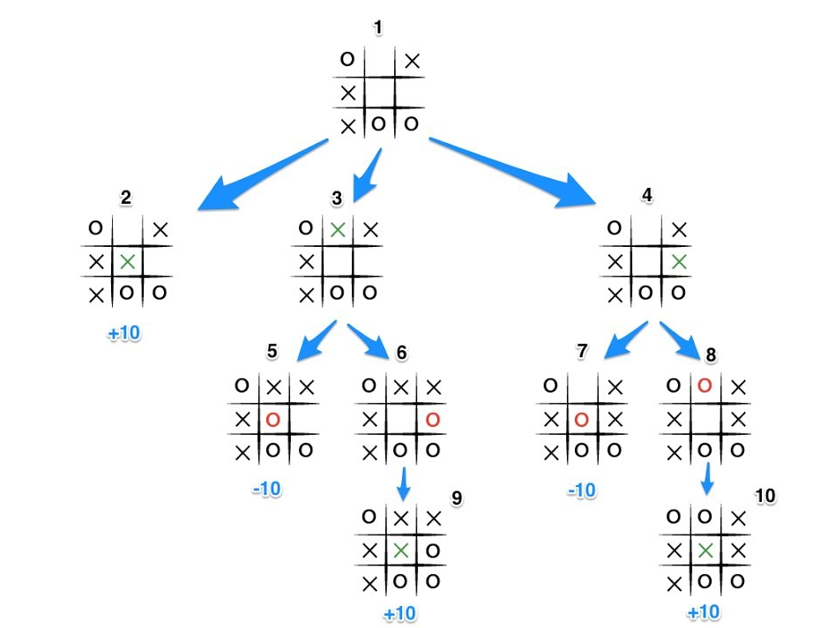
Basic Terminology
State Space

Slide 12
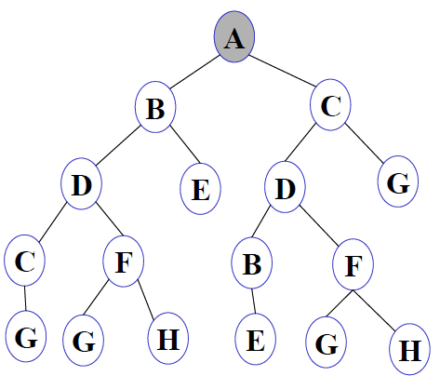
Basic Terminology
To simplify state space, we will represent each state with a simple node.

Slide 13


Basic Terminology
Goal Test
A way to determine whether a given state is a goal state.
Goal State ✅
Not a Goal State ❌

Slide 14
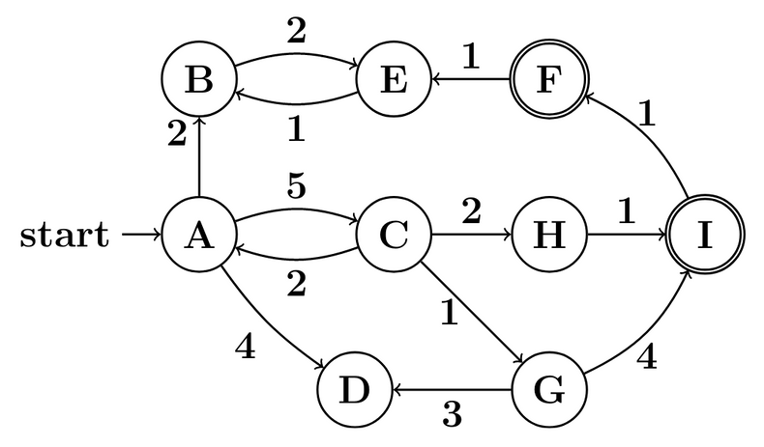

Basic Terminology
Path Cost
Path cost is the total cost of a sequence of actions from the initial state to the goal state.
Cost of$A−>C−>G−>D = 5+1+3=9$

Slide 15
Search Problem
A search problem is a formal representation of a problem that an AI agent can solve by exploring different states to reach a goal.
A search problem is defined by five elements:
Initial State
Actions
Transition Model
Goal Test
Path Cost Function

Slide 16
Search Problem Solution
Solution
A sequence of actions that leads from the initial state to a goal state.
Optimal Solution
A solution that has the lowest path cost among all solutions.

Slide 17
node
A node is a data structure that represents a state in the search tree, along with information needed to reconstruct the path taken to reach that state.
Each node typically stores:
State – the actual state in the problem domain.
Parent – The node from which this node was generated.
Action – the action taken to reach this state from the parent.
Path Cost – Cost from the initial state to this node.

Slide 18
General Approach
The goal of a search algorithm is to explore the state space starting from the initial state, using actions to generate new states, until it finds a goal state.
Steps:
Start with a frontier that contains the initial node.
‘frontier’ is a data structure that contains all the node we could explore next, that we haven’t explored yet.
2. Repeat:
3. If the frontier is empty, then no solution exists.
4. Remove a node from the frontier.
5. If node contains goal state return the solution.
6. Expand node, add resulting nodes to the frontier.

Slide 19
General Approach
Suppose the initial state is A and the goal state is D.
The goal of our search problem is to find a path from A to D.
Let’s apply the general approach.
A
B
E
C
D
F

Slide 20
General Approach
Frontier
B
C
E
D
A
F
A
1. Start with a frontier that contains the initial node.
2. Repeat:
3. If the frontier is empty, then no solution exists.
4. Remove a node from the frontier.
5. If node contains goal state return the solution.
6. Expand node, add resulting nodes to the frontier.
B
E
C
D
F

Slide 21
General Approach
1. Start with a frontier that contains the initial node.
2. Repeat:
3. If the frontier is empty, then no solution exists.
4. Remove a node from the frontier.
5. If node contains goal state return the solution.
6. Expand node, add resulting nodes to the frontier.
A
Will this algorithm work on this graph?
B
Is there any problem with this algorithm?
C

Slide 22
Revised Approach
Start with a frontier that contains the initial node.
Start with an empty set.
2. Repeat:
3. If the frontier is empty, then no solution exists.
4. Remove a node from the frontier.
5. If node contains goal state return the solution.
6. Add the node to the explored set.
7. Expand node, add resulting nodes to the frontier if they aren’t already in the frontier or the explored set.

Slide 23
Measuring Performance
Completeness
Is the algorithm guaranteed to find a solution when there is one?
Optimality
Does the strategy find the optimal solution?
Time Complexity
How long does it take to find a solution?
Space Complexity
How much memory is needed to perform the search?

Slide 24
Complexity in AI
Graph is often represented implicitly.
Initial state, actions and transition model.
Often infinite.
Traditional complexity doesn’t apply here.

Slide 25
Complexity in AI
Complexity is represented in terms of three quantities.
Branching factor(b)
Maximum number of successor of any node.
Depth of the shallowest goal(d)
The smallest number of steps needed to reach a goal from the root.
Maximum path length(m)
Longest sequence of actions without repeating state.

Slide 26
Complexity in AI
Time complexity is measured in number of nodes generated.
Space complexity is measured in maximum number of nodes stored in memory at any one time.

Slide 27
Effectiveness of Algorithm
Search Cost
Time spent computing the solution.
Milliseconds, CPU cycles, or node expanded.
Path Cost
Quality of the final solution in domain terms.
Money, distance, etc.
Total Cost = Search Cost + Path Cost

Slide 28
Uninformed Search
Strategies that have no additional information about states beyond that provided in the problem definition.
Only know
Problem definition.
How to generate successor.
How to recognize a goal state.
Strategies only differ in the order they expand nodes.

Slide 29
Breadth-First Search
The shallowest unexpanded node is chosen for expansion.
Achieved by using a FIFO queue as frontier.
New nodes go the back; old nodes are expanded first.
General approach is slightly changed.
Goal test is applied during generation of node.
Always finds the shallowest path to any node.

Slide 30
Breadth-First Search
function BREADTH-FIRST-SEARCH(problem) returns a solution, or failure
node ←a node with STATE = problem.INITIAL-STATE,PATH-COST =0
if problem.GOAL-TEST(node.STATE) then return SOLUTION(node)
frontier ←a FIFO queue with node as the only element
explored ←an empty set
loop do
if EMPTY?(frontier) then return failure
node ←POP(frontier) /* chooses the shallowest node in frontier */
add node.STATE to explored
for each action in problem.ACTIONS(node.STATE) do
child ←CHILD-NODE(problem,node,action)
if child.STATE is not in explored or frontier then
if problem.GOAL-TEST(child.STATE) then return SOLUTION(child)
frontier ←INSERT(child,frontier)

Slide 31
BFS Performance
Is it Complete?
Is it Optimal?
Notes:
Only if the path cost is a non-decreasing function of the depth of the node.

Slide 32

BFS Performance
What about time complexity?
We are not talking about $O(V+E)$.
Think about branching factor and depth.

Slide 33
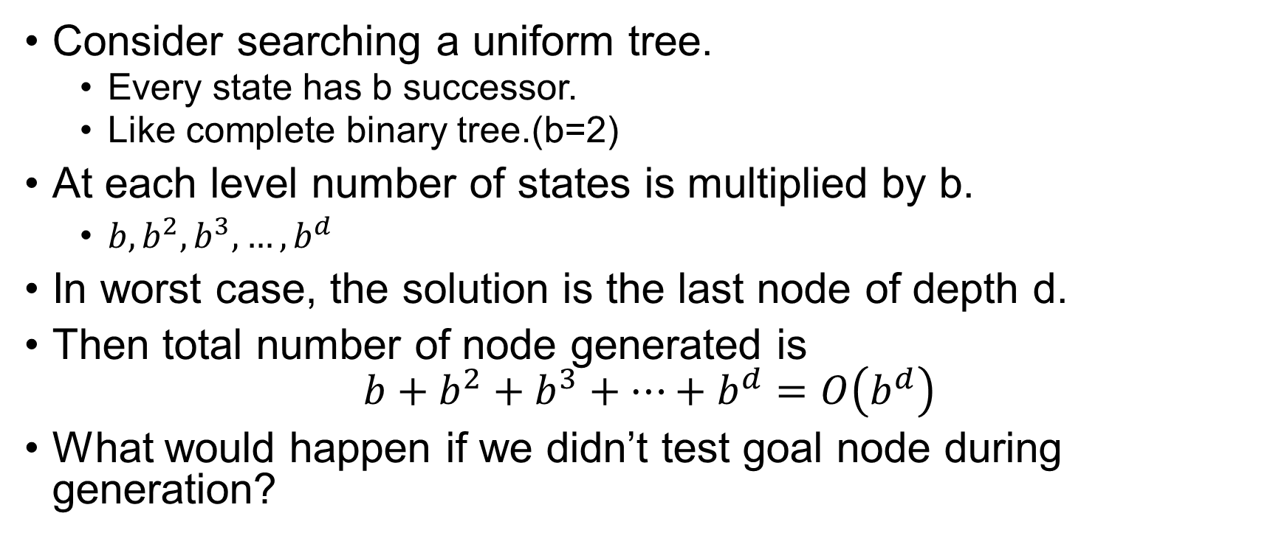
BFS Performance
Consider searching a uniform tree.
Every state has b successor.
Like complete binary tree.(b=2)
At each level number of states is multiplied by b.
$b, b^{2}, b^{3},…, b^{d}$
In worst case, the solution is the last node of depth d.
Then total number of node generated is $b+b^{2}+b^{3}+…+b^{d}=O\left(b^{d}\right)$
What would happen if we didn’t test goal node during generation?

Slide 34

BFS Performance
How about space complexity?
Every node generated remains in the memory.
Either in frontier, or in the explored set.
Hence, $O(b^{d})$.

Slide 35
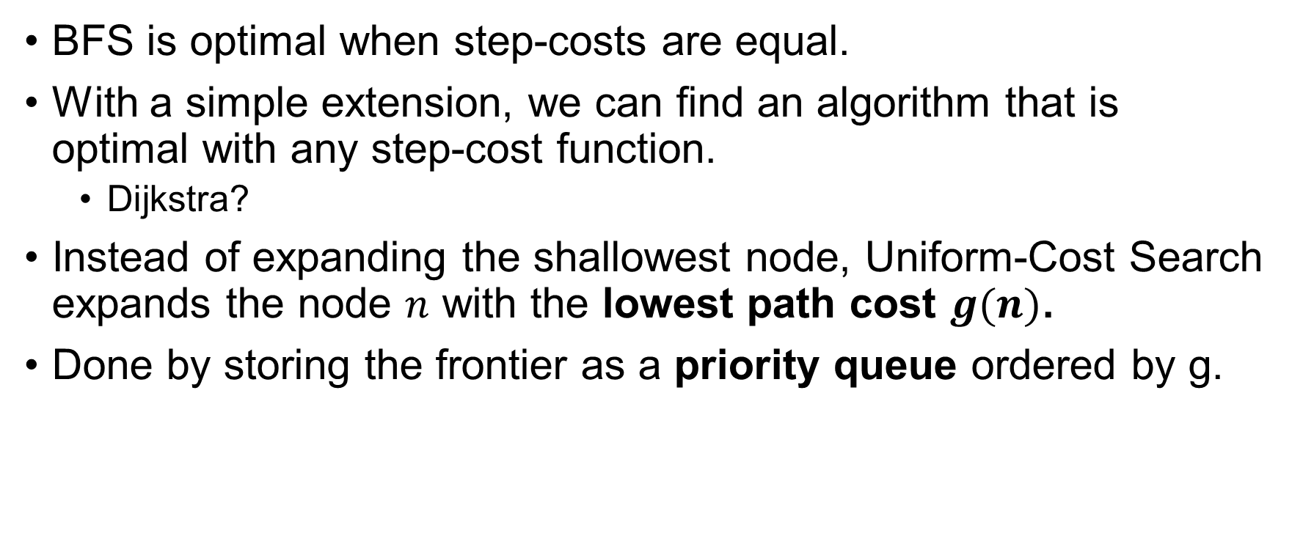
Uniform-cost Search
BFS is optimal when step-costs are equal.
With a simple extension, we can find an algorithm that is optimal with any step-cost function.
Dijkstra?
Instead of expanding the shallowest node, Uniform-Cost Search expands the node $n$ with the lowest path cost $g(n)$.
Done by storing the frontier as a priority queue ordered by g.

Slide 36
Uniform-cost Search
function UNIFORM-COST-SEARCH(problem) returns a solution, or failure
node ←a node with STATE = problem.INITIAL-STATE, PATH-COST =0
frontier ←a priority queue ordered by PATH-COST, with node as the only element
explored ←an empty set
loop do
if EMPTY?(frontier) then return failure
node ←POP(frontier) /* chooses the lowest-cost node in frontier */
if problem.GOAL-TEST(node.STATE) then return SOLUTION(node)
add node.STATE to explored
for each action in problem.ACTIONS(node.STATE) do
child ←CHILD-NODE(problem,node,action)
if child.STATE is not in explored or frontier then
frontier ←INSERT(child,frontier)
else if child.STATE is in frontier with higher PATH-COST then
replace that frontier node with child
Notes:
Goal test is done when selected for expansion, test of better path.

Slide 37
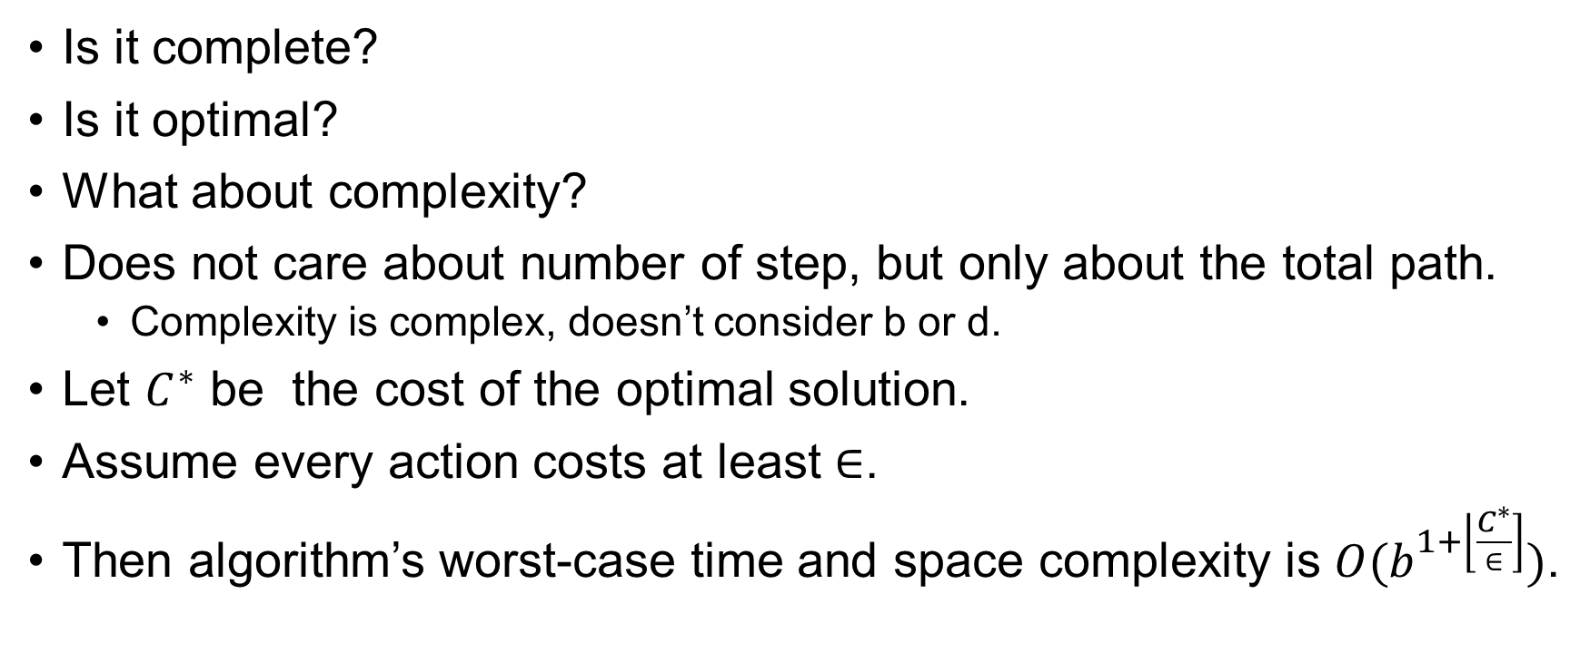
Performance of Uniform-cost Search
Is it complete?
Is it optimal?
What about complexity?
Does not care about number of step, but only about the total path.
Complexity is complex, doesn’t consider b or d.
Let $C^{∗}$ be the cost of the optimal solution.
Assume every action costs at least $∈$.
Then algorithm’s worst-case time and space complexity is $O(b^{1+\left\lfloor \frac{C^{∗}}{∈}\right]})$.

Slide 38
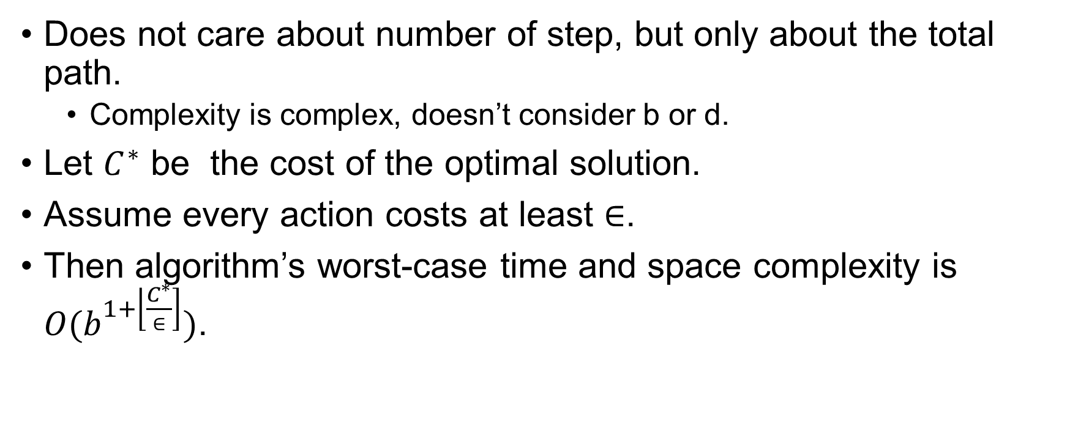
Performance of Uniform-cost Search
Does not care about number of step, but only about the total path.
Complexity is complex, doesn’t consider b or d.
Let $C^{∗}$ be the cost of the optimal solution.
Assume every action costs at least $∈$.
Then algorithm’s worst-case time and space complexity is $O(b^{1+\left\lfloor \frac{C^{∗}}{∈}\right]})$.

Slide 39
Depth-First Search
Expands the deepest node in the current frontier.
Uses a LIFO queue.
Stack.
Most recently generated node is chosen for expansion.
Often implemented in recursive manner.

Slide 40
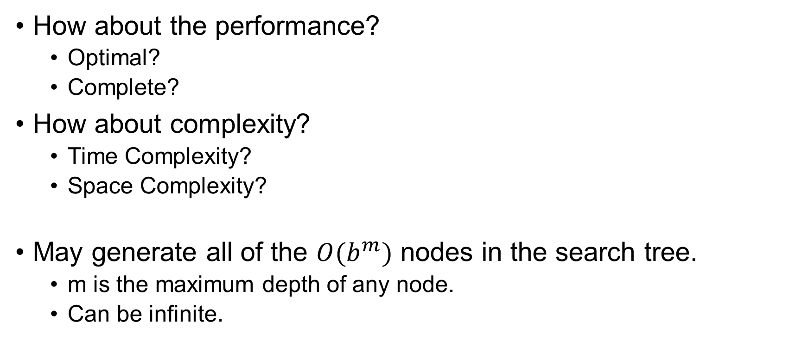
Depth-First Search
How about the performance?
Optimal?
Complete?
How about complexity?
Time Complexity?
Space Complexity?
May generate all of the $O(b^{m})$ nodes in the search tree.
m is the maximum depth of any node.
Can be infinite.

Slide 41
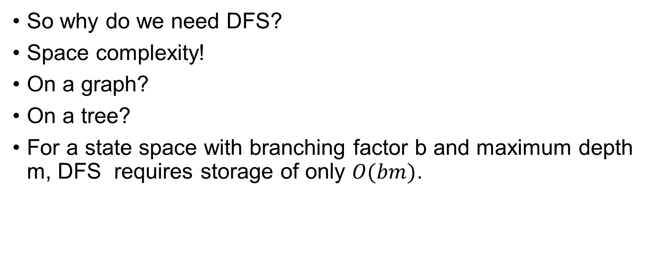
Depth-First Search
So why do we need DFS?
Space complexity!
On a graph?
On a tree?
For a state space with branching factor b and maximum depth m, DFS requires storage of only $O(bm)$.

Slide 42
Depth-Limited Search
DFS fails in infinite state space.
This is solved by depth-limited search.
A predetermined depth limit (l) is selected first.
DFS treats the nodes at level l as leaf.
The successors of level l+1 are ignored.
Is it complete?
Is it optimal?

Slide 43
Depth-Limited Search
function DEPTH-LIMITED-SEARCH(problem,limit) returns a solution, or failure/cutoff
return RECURSIVE-DLS(MAKE-NODE(problem.INITIAL-STATE),problem,limit)
function RECURSIVE-DLS(node,problem,limit) returns a solution, or failure/cutoff
if problem.GOAL-TEST(node.STATE) then return SOLUTION(node)
else if limit =0 then return cutoff
else
cutoff occurred?←false
for each action in problem.ACTIONS(node.STATE) do
child ←CHILD-NODE(problem,node,action)
result ←RECURSIVE-DLS(child,problem,limit − 1)
if result = cutoff then cutoff occurred?←true
else if result= failure then return result
if cutoff occurred? then return cutoff else return failure

Slide 44
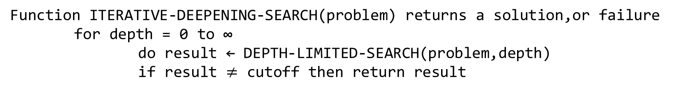
Iterative Deepening DFS
IDS gradually increases the depth limit, until the goal is found.
Function ITERATIVE-DEEPENING-SEARCH(problem) returns a solution,or failure for depth = 0 to ∞
do result ← DEPTH-LIMITED-SEARCH(problem,depth)
if result $≠$ cutoff then return result

Slide 45
Iterative Deepening DFS
Combines the benefit of both BFS and DFS.
Memory complexity?
O(bd)
Complete?
How about time complexity?
Aren’t we generating same node multiple times?

Slide 46
Iterative Deepening DFS
Turns out it’s not that costly.
Most of the nodes are in the bottom level.
How does it compare with BFS?

Slide 47
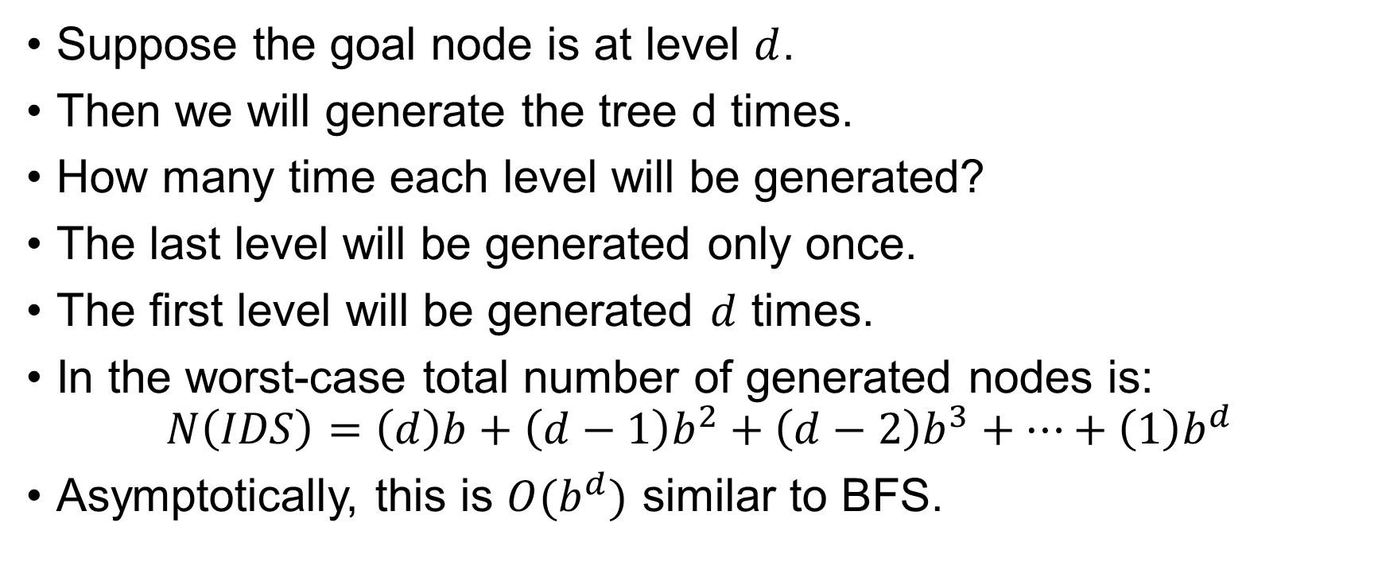
Iterative Deepening DFS
Suppose the goal node is at level $d$.
Then we will generate the tree d times.
How many time each level will be generated?
The last level will be generated only once.
The first level will be generated $d$ times.
In the worst-case total number of generated nodes is:
$$N\left(IDS\right)=\left(d\right)b+\left(d−1\right)b^{2}+\left(d−2\right)b^{3}+…+\left(1\right)b^{d}$$
Asymptotically, this is $O(b^{d})$ similar to BFS.

Slide 48
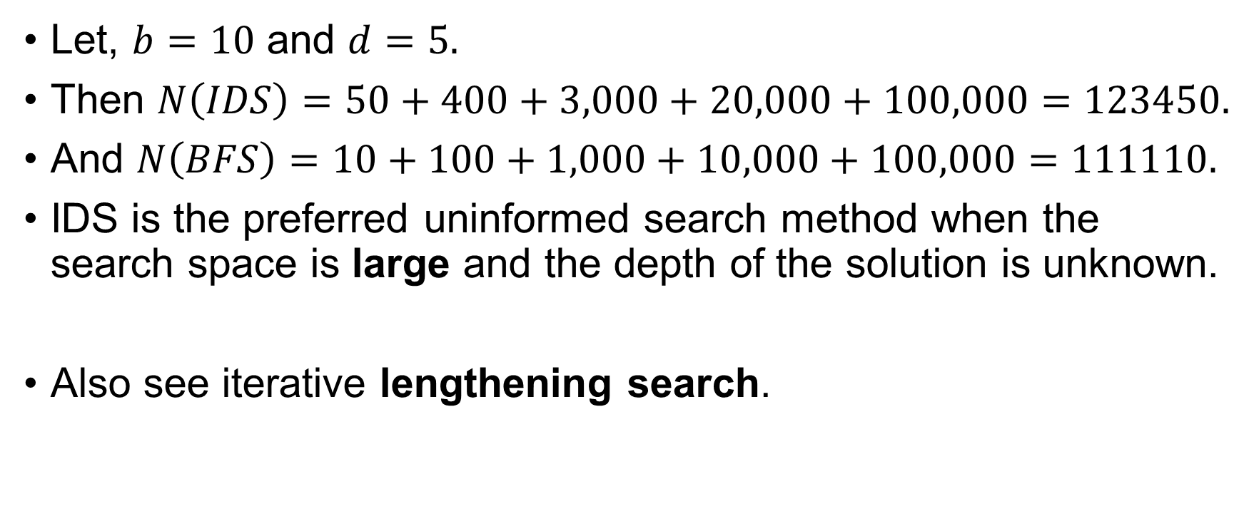
Iterative Deepening DFS
Let, $b=10$ and $d=5.$
Then $N\left(IDS\right)=50+400+3,000+20,000+100,000=123450.$
And $N\left(BFS\right)=10+100+1,000+10,000+100,000=111110.$
IDS is the preferred uninformed search method when the search space is large and the depth of the solution is unknown.
Also see iterative lengthening search.

Slide 49
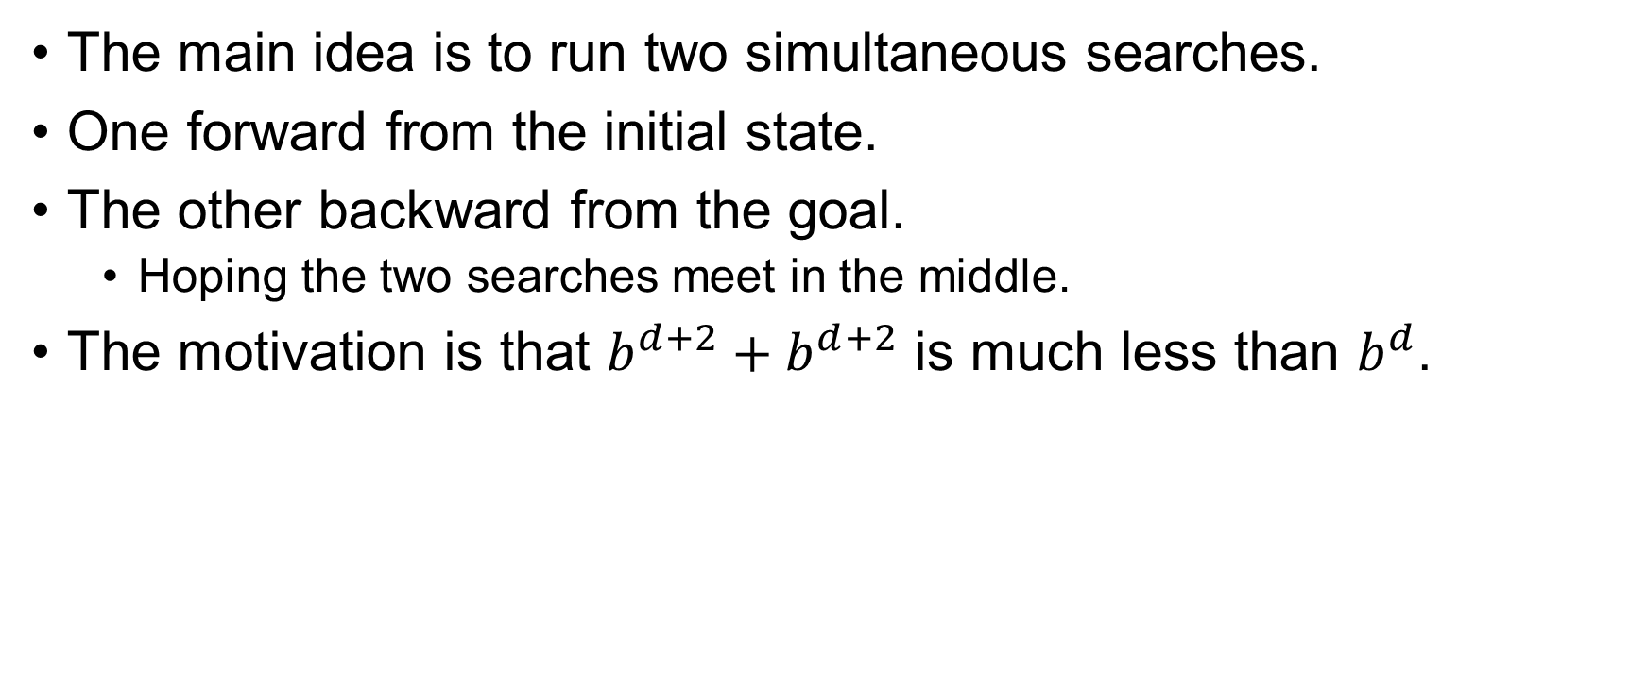
Bidirectional Search
The main idea is to run two simultaneous searches.
One forward from the initial state.
The other backward from the goal.
Hoping the two searches meet in the middle.
The motivation is that $b^{d+2}+b^{d+2}$ is much less than $b^{d}$.

Slide 50
Bidirectional Search
Goal test is replaced with a check to see whether the frontiers of the two searches intersect.
If they do a solution is found.
Now this solution might not be the optimal one.
The check can be done when each node is generated or selected for expansion and, with a hash table, will take constant time.

Slide 51
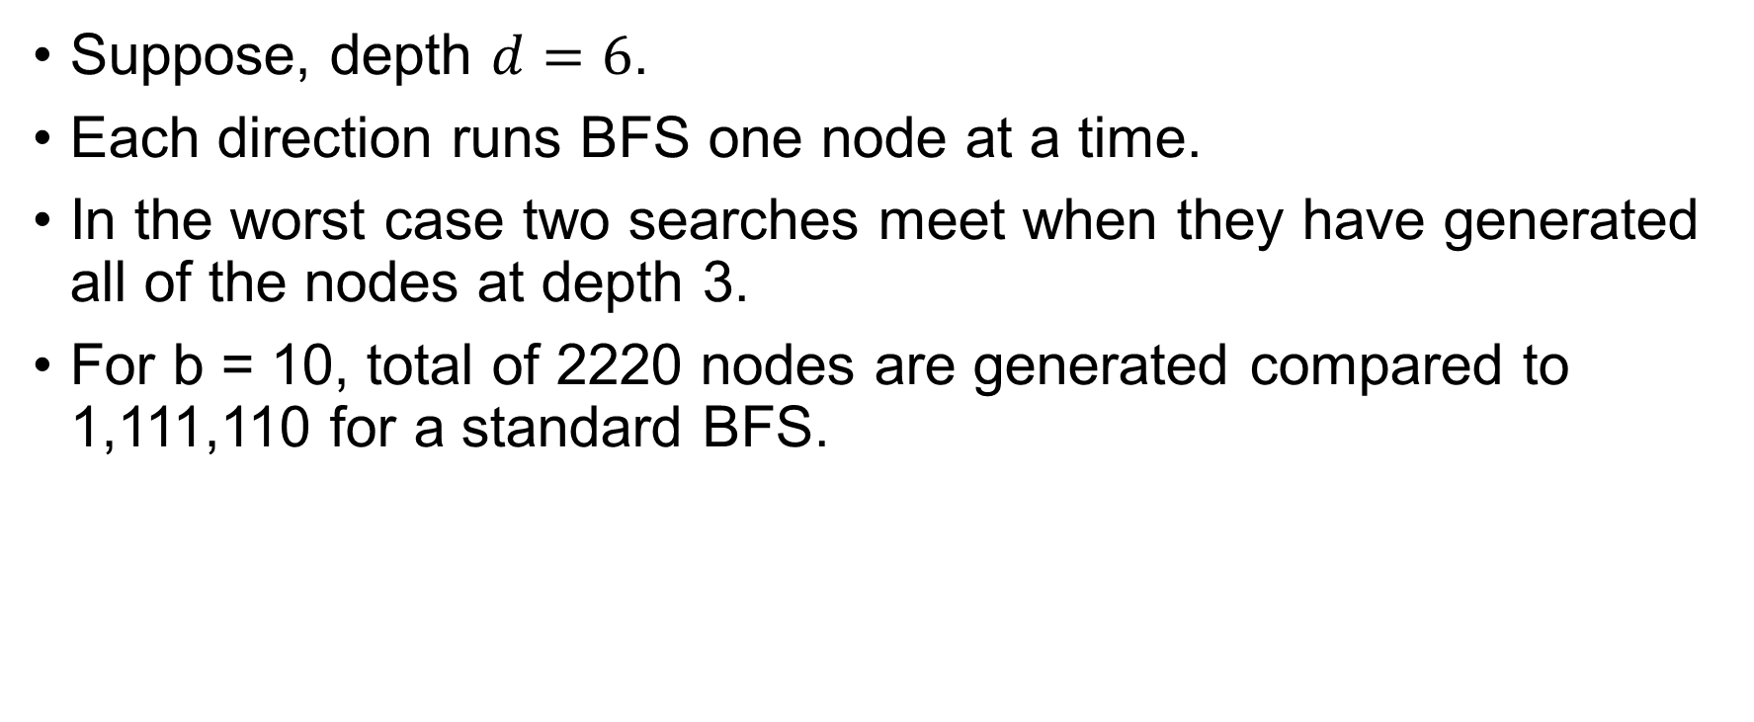
Bidirectional Search
Suppose, depth $d=6$.
Each direction runs BFS one node at a time.
In the worst case two searches meet when they have generated all of the nodes at depth 3.
For b = 10, total of 2220 nodes are generated compared to 1,111,110 for a standard BFS.

Slide 52
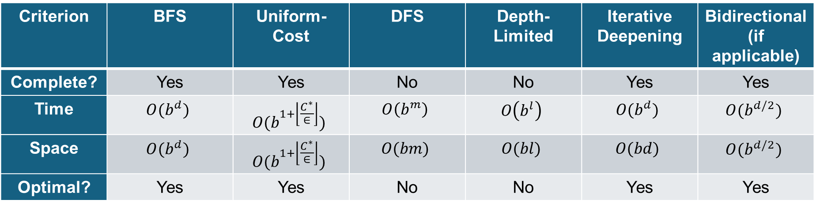
Comparing Uninformed Search
Criterion | BFS | Uniform-Cost | DFS | Depth-Limited | Iterative Deepening | Bidirectional(if applicable)
Complete? | Yes | Yes | No | No | Yes | Yes
Time | $$O(b^{d})$$ | $$O(b^{1+\left\lfloor \frac{C^{∗}}{∈}\right\rfloor })$$ | $$O\left(b^{m}\right)$$ | $$O\left(b^{l}\right)$$ | $$O(b^{d})$$ | $$O(b^{d/2})$$
Space | $$O(b^{d})$$ | $$O(b^{1+\left\lfloor \frac{C^{∗}}{∈}\right\rfloor })$$ | $$O(bm)$$ | $$O(bl)$$ | $$O(bd)$$ | $$O(b^{d/2})$$
Optimal? | Yes | Yes | No | No | Yes | Yes

Slide 53
Informed Search
Informed Search algorithms use problem-specific knowledge (called a heuristic) to make better decision about which path to follow toward the goal.

Slide 54
Best-First Search
The general approach is called best-first search.
A node is selected for expansion based on an evaluation function, $f(n)$.
The node with the lowest evaluation is expanded first.
The choice of $f$ determines the search strategy.

Slide 55
Heuristic Function
Most best-first search algorithms include as a component of $f$ a heuristic function, denoted $h(n)$.
$$h\left(n\right)=estimated cost of the cheapest path from the state at a node n to a goal state.$$

Slide 56
Greedy Best-First Search
Greedy best-first search selects the node that appears to be closest to the goal, based on the heuristic function $h(n)$ only.
Let’s understand this with the maze problem.

Slide 57
Greedy Best First Search
Consider the following maze.
The agent wants to go to cell B from the cell A.
Our target is to find the shortest path.
 |  |  |  |  |  |  |  |  |  |  | B
A

Slide 58
Greedy Best First Search
Between C and D which point will lead us to B faster?
 |  |  |  |  |  |  |  |  |  |  | B
 |  |  |  |  |  |  | D
 | C
A

Slide 59
Greedy Best First Search
Let’s consider the Manhattan distance.
We will use this as the heuristic function.
$$h\left(C\right)=13$$
 |  |  |  |  |  |  |  |  |  |  | B
 |  |  |  |  |  |  | D
 | C
A
$h\left(D\right)=$6

Slide 60
Greedy Best First Search
Let’s find the $h(n)$ for all the cells.
11 |  | 9 |  | 7 |  |  |  | 3 | 2 |  | B
12 |  | 10 |  | 8 | 7 | 6 |  | 4 |  |  | 1
13 | 12 | 11 |  | 9 |  | 7 | 6 | 5 |  |  | 2
 | 13 |  |  | 10 |  | 8 |  | 6 |  |  | 3
 | 14 | 13 | 12 | 11 |  | 9 |  | 7 | 6 | 5 | 4
 |  |  | 13 |  |  | 10
A | 16 | 15 | 14 |  |  | 11 | 10 | 9 | 8 | 7 | 6

Slide 61
Greedy Best First Search
11 |  | 9 |  | 7 |  |  |  | 3 | 2 |  | B
12 |  | 10 |  | 8 | 7 | 6 |  | 4 |  |  | 1
13 | 12 | 11 |  | 9 |  | 7 | 6 | 5 |  |  | 2
 | 13 |  |  | 10 |  | 8 |  | 6 |  |  | 3
 | 14 | 13 | 12 | 11 |  | 9 |  | 7 | 6 | 5 | 4
 |  |  | 13 |  |  | 10
A | 16 | 15 | 14 |  |  | 11 | 10 | 9 | 8 | 7 | 6

Slide 62
Greedy Best First Search
Now, let’s apply the same algorithm on the following maze.
Is it the shortest path?
 | 10 | 9 | 8 | 7 | 6 | 5 | 4 | 3 | 2 | 1 | B
 | 11 |  |  |  |  |  |  |  |  |  | 1
 | 12 |  | 10 | 9 | 8 | 7 | 6 | 5 | 4 |  | 2
 | 13 |  | 11 |  |  |  |  |  | 5 |  | 3
 | 14 | 13 | 12 |  | 10 | 9 | 8 | 7 | 6 |  | 4
 |  |  | 13 |  | 11 |  |  |  |  |  | 5
A | 16 | 15 | 14 |  | 12 | 11 | 10 | 9 | 8 | 7 | 6
Cost = 33

Slide 63
Greedy Best First Search
 | 10 | 9 | 8 | 7 | 6 | 5 | 4 | 3 | 2 | 1 | B
 | 11 |  |  |  |  |  |  |  |  |  | 1
 | 12 |  | 10 | 9 | 8 | 7 | 6 | 5 | 4 |  | 2
 | 13 |  | 11 |  |  |  |  |  | 5 |  | 3
 | 14 | 13 | 12 |  | 10 | 9 | 8 | 7 | 6 |  | 4
 |  |  | 13 |  | 11 |  |  |  |  |  | 5
A | 16 | 15 | 14 |  | 12 | 11 | 10 | 9 | 8 | 7 | 6
Cost = 21

Slide 64
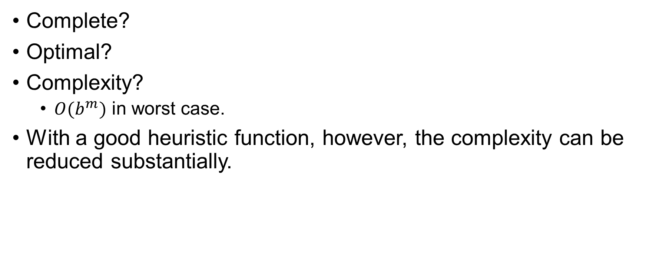
Greedy Best First Search
Complete?
Optimal?
Complexity?
$O(b^{m})$ in worst case.
With a good heuristic function, however, the complexity can be reduced substantially.

Slide 65
A*-Search
Most widely known form of best-first search.
It evaluates nodes by combining $g(n)$, the cost to reach the node, and $h(n)$, the cost to get from the node to the goal: $f\left(n\right)=h\left(n\right)+g\left(n\right)$
Since $g(n)$ gives the path cost from the start node to node $n$, and $h(n)$ is the estimated cost of the cheapest path from the node to the goal: $f\left(n\right)=estimated cost of the cheapest solution through n$

Slide 66
A*-Search
10+11
9+12
8+13
7+14
5+16
3+18
2+19
1+20
 | 10 | 9 | 8 | 7 | 6 | 5 | 4 | 3 | 2 | 1 | B
 | 11 |  |  |  |  |  |  |  |  |  | 1
 | 12 |  | 10 | 9 | 8 | 7 | 6 | 5 | 4 |  | 2
 | 13 |  | 11 |  |  |  |  |  | 5 |  | 3
 | 14 | 13 | 12 |  | 10 | 9 | 8 | 7 | 6 |  | 4
 |  |  | 13 |  | 11 |  |  |  |  |  | 5
A | 16 | 15 | 14 |  | 12 | 11 | 10 | 9 | 8 | 7 | 6
6+15
4+17
11+10
12+9
10+7
9+8
8+9
7+10
6+11
5+12
4+13
13+8
11+6
5+14
14+7
13+6
12+5
13+4
16+1
15+2
14+3

Slide 67
Greedy Best First Search/ A* Search
GreedyBestFirstSearch(problem):
node := create_node(problem.initial_state,
parent =null, action = null, path_cost = 0)
frontier := PriorityQueue ordered by h(n)
frontier.insert(node,f(node.state))
explored := empty set
while frontier is not empty:
node := frontier.pop()
if problem.is_goal(node.state):
return solution_path(node)
explored.add(node.state)
for each action in problem.actions(node.state):
child_state := problem.result(node.state,action)
step_cost := problem.step_cost(node.state, action,
child_state)
child_node := create_node(child_state,
parent=node, action = action,
path_cost = node.path_cost + step_cost)
if child_state not in explored and not in frontier:
f_value := f(child_state)
frontier.insert(child_node, f_value)
return failure

Slide 68
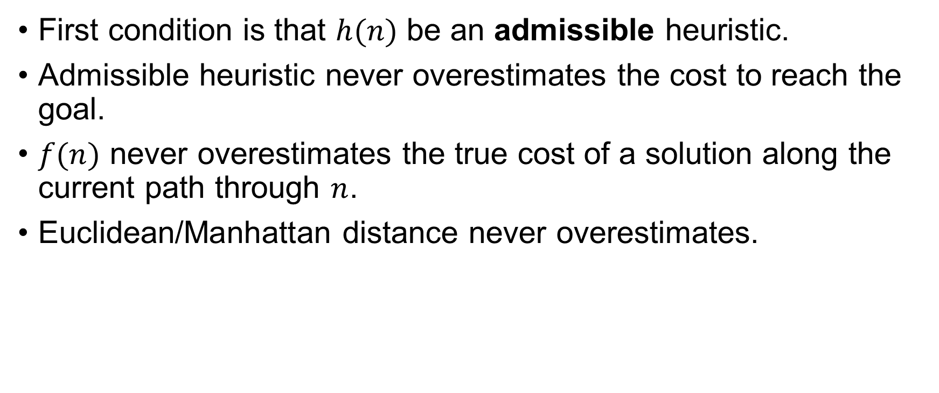
Condition of Optimality
First condition is that $h(n)$ be an admissible heuristic.
Admissible heuristic never overestimates the cost to reach the goal.
$f(n)$ never overestimates the true cost of a solution along the current path through $n$.
Euclidean/Manhattan distance never overestimates.

Slide 69
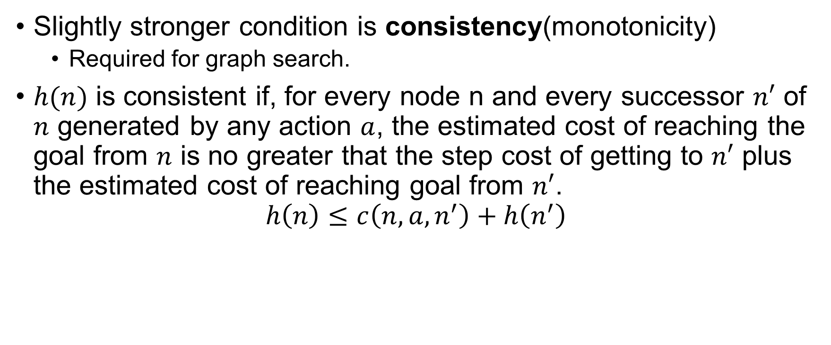
Condition of Optimality
Slightly stronger condition is consistency(monotonicity)
Required for graph search.
$h(n)$ is consistent if, for every node n and every successor $n′$ of $n$ generated by any action $a$, the estimated cost of reaching the goal from $n$ is no greater that the step cost of getting to $n′$ plus the estimated cost of reaching goal from $n′$.
$$h\left(n\right)≤c\left(n, a, n^{′}\right)+h\left(n^{′}\right)$$

Slide 70


Optimality of $A^{∗}$
The tree search is optimal if $h(n)$ is admissible.
The graph search is optimal if $h(n)$ is consistent.

Slide 71

Memory-bounded Heuristic Search
Simplest way to reduce memory is to use iterative deepening.
The algorithm is called iterative-deepening $A^{∗} ({IDA}^{∗})$.
The cut-off value is the $f−$cost ($g+h)$.

Slide 72
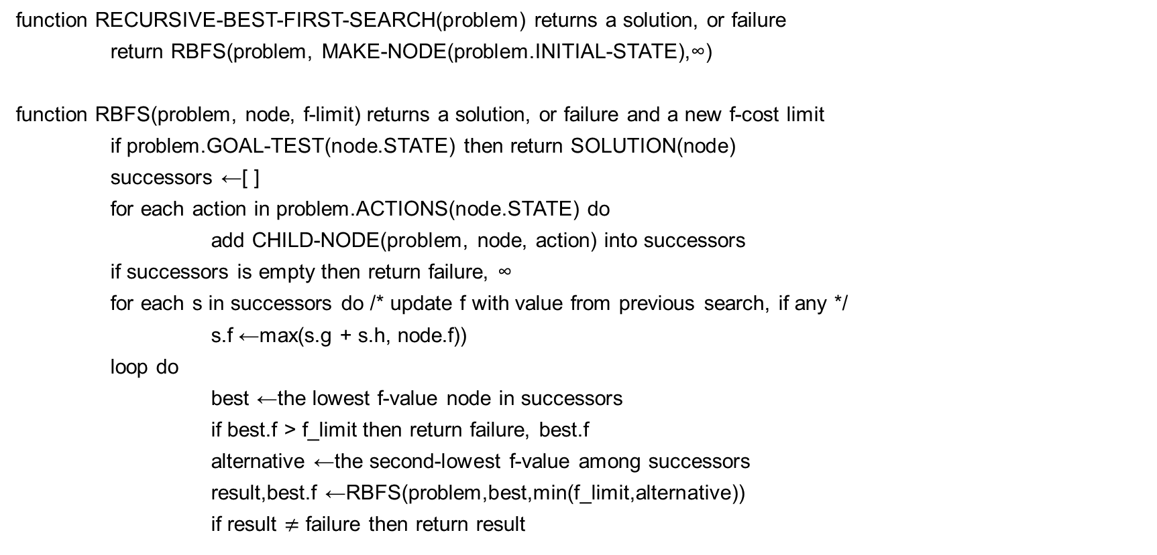
Recursive best-first Search
function RECURSIVE-BEST-FIRST-SEARCH(problem) returns a solution, or failure
return RBFS(problem, MAKE-NODE(problem.INITIAL-STATE),∞)
function RBFS(problem, node, f-limit) returns a solution, or failure and a new f-cost limit
if problem.GOAL-TEST(node.STATE) then return SOLUTION(node)
successors ←[ ]
for each action in problem.ACTIONS(node.STATE) do
add CHILD-NODE(problem, node, action) into successors
if successors is empty then return failure, ∞
for each s in successors do /* update f with value from previous search, if any */
s.f ←max(s.g + s.h, node.f))
loop do
best ←the lowest f-value node in successors
if best.f > f_limit then return failure, best.f
alternative ←the second-lowest f-value among successors
result,best.f ←RBFS(problem,best,min(f_limit,alternative))
if result $≠$ failure then return result

Slide 73
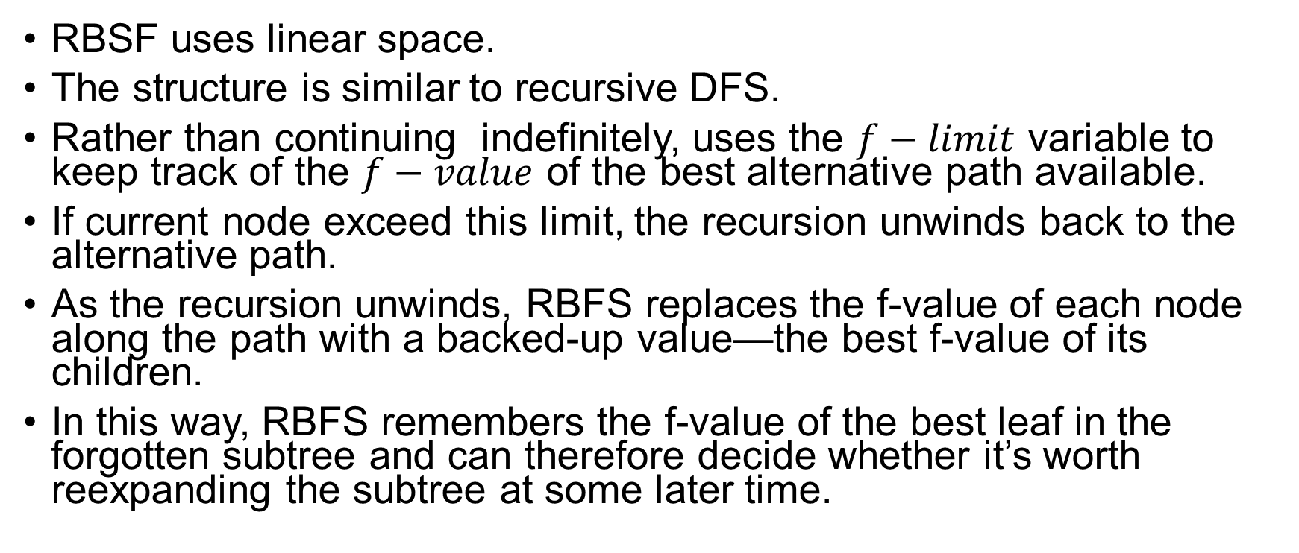
Recursive best-first Search
RBSF uses linear space.
The structure is similar to recursive DFS.
Rather than continuing indefinitely, uses the $f−limit$ variable to keep track of the $f−value$ of the best alternative path available.
If current node exceed this limit, the recursion unwinds back to the alternative path.
As the recursion unwinds, RBFS replaces the f-value of each node along the path with a backed-up value—the best f-value of its children.
In this way, RBFS remembers the f-value of the best leaf in the forgotten subtree and can therefore decide whether it’s worth reexpanding the subtree at some later time.

